Slide 1
SmartHire: AI Recruitment Software
Team members:
Abhinav S (Team Leader) – CSE(AIML) – B
Nithish Praba M P – CSE(AIML) – B
Pranavaashree – ECE – A

Slide 2
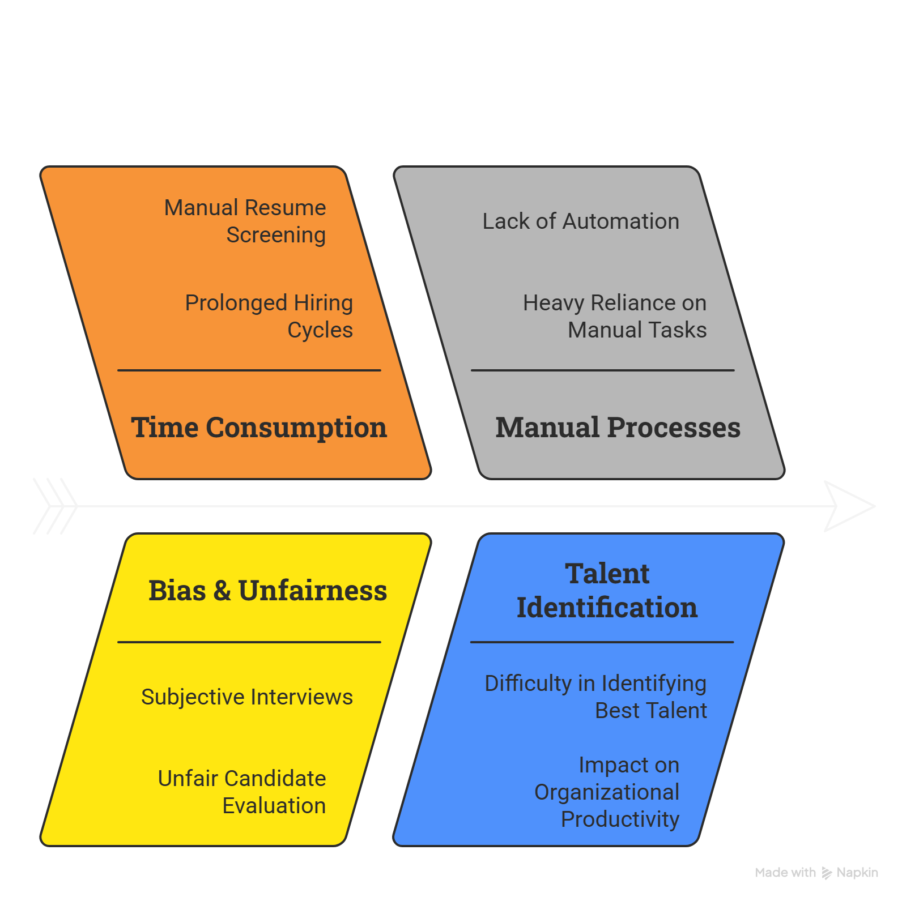
Problem Statement

Slide 3
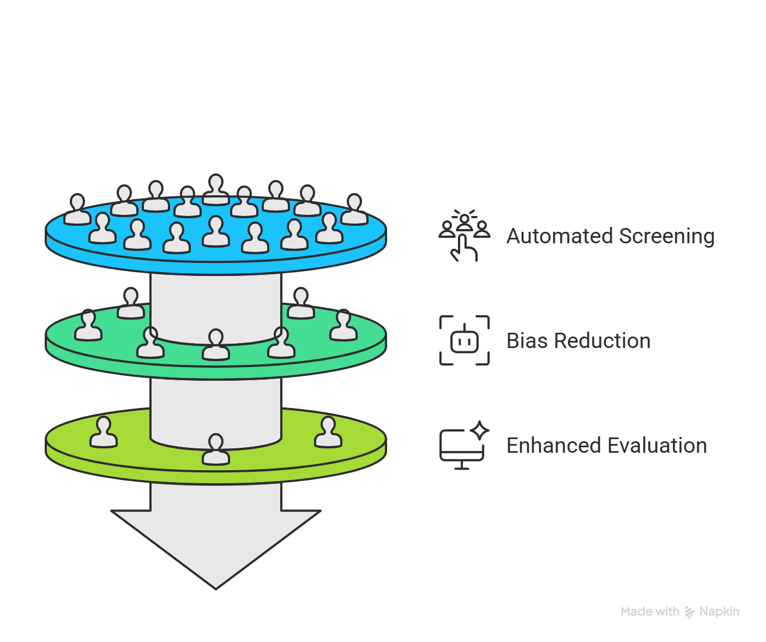
Objective of Proposed Solution

Slide 4
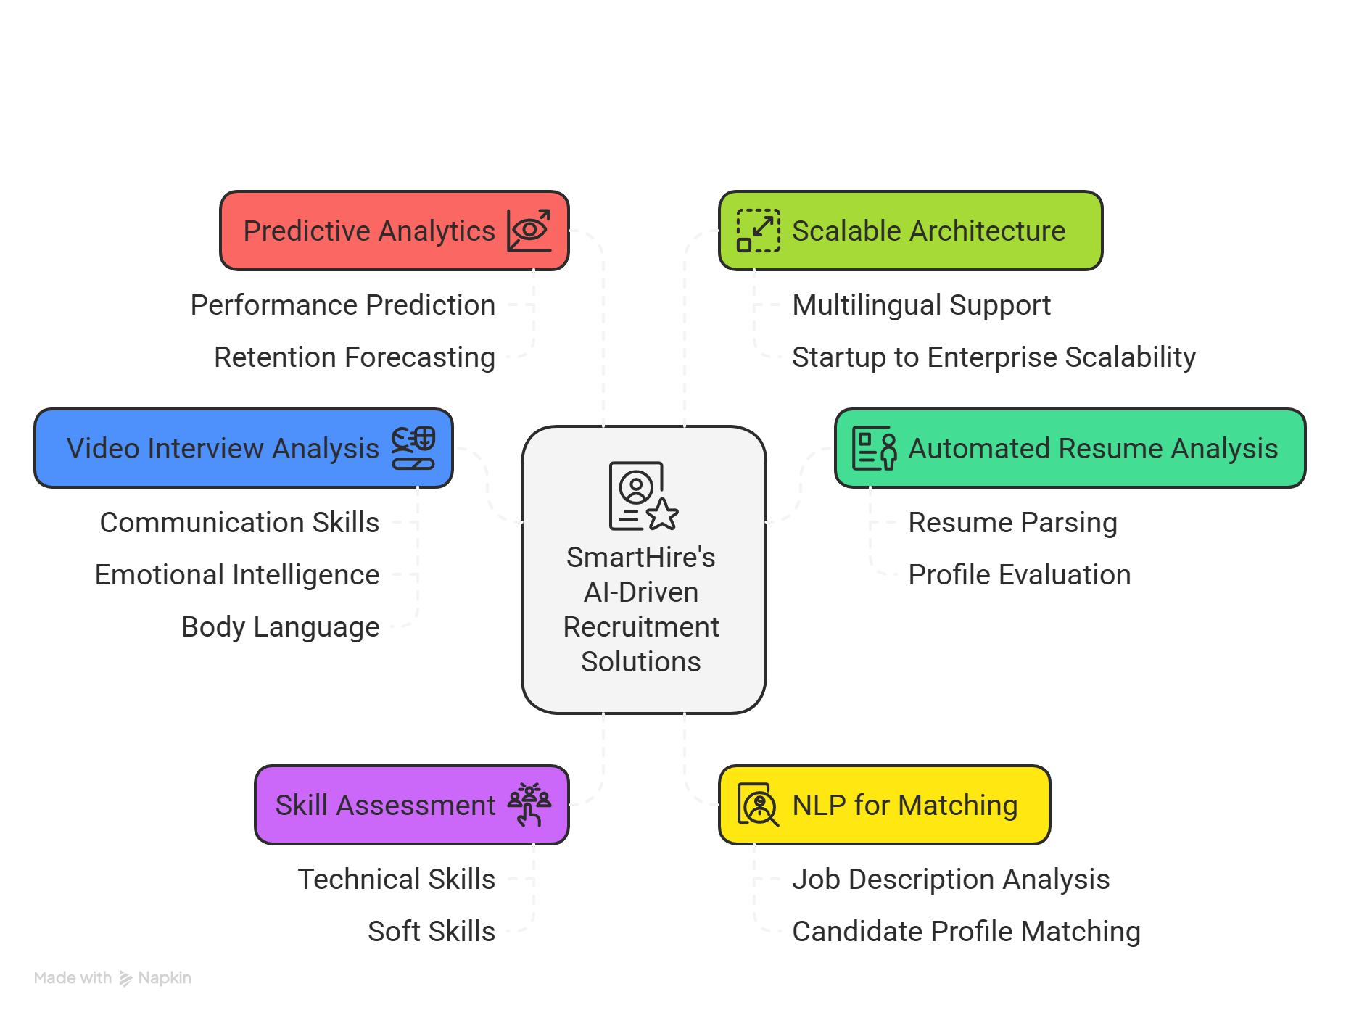
Proposed Solution

Slide 5
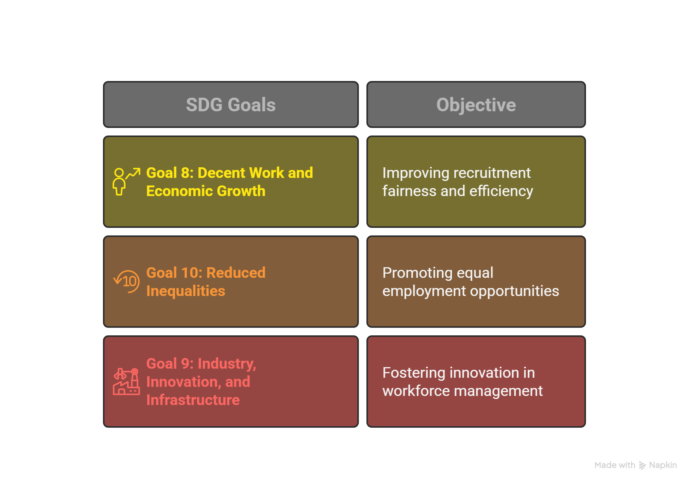
SDG Goals

Slide 6
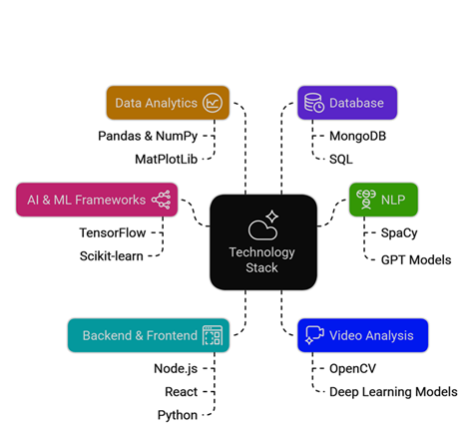
Technology & Tools Used

Slide 7
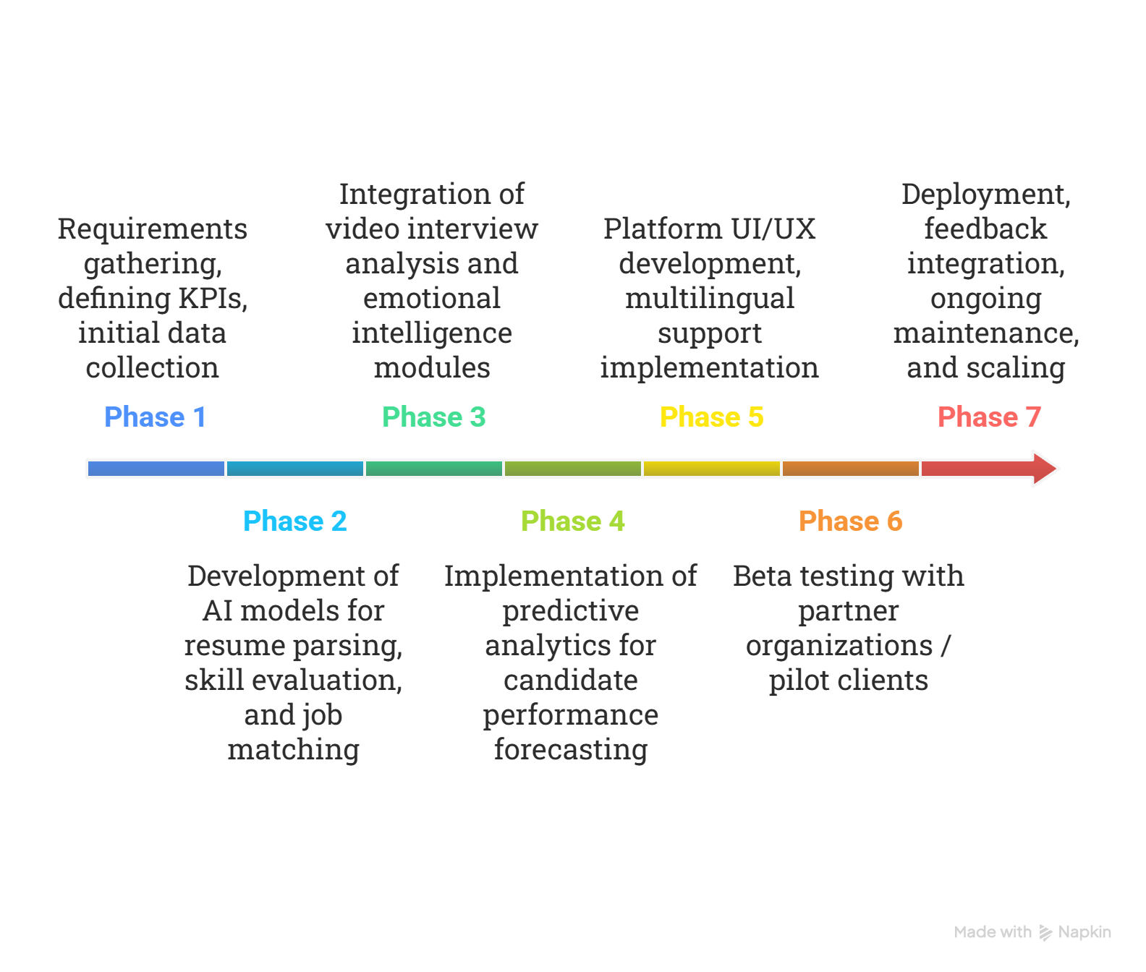
Implementation

Slide 8
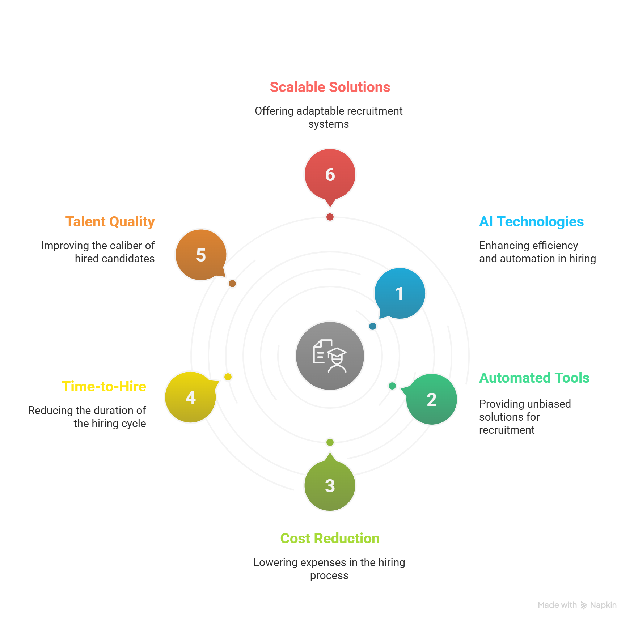
Market Demand

Slide 9
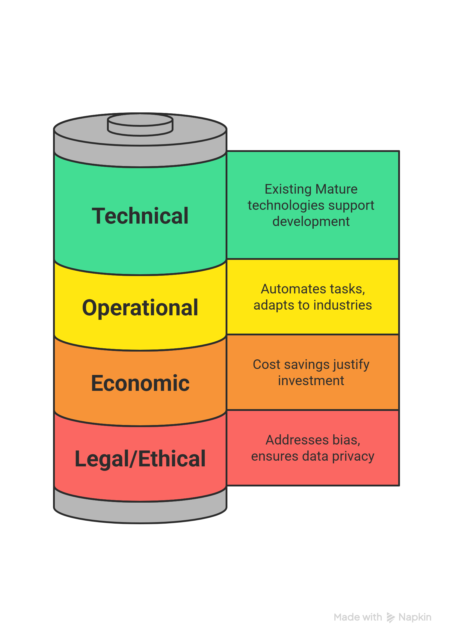
Feasibility

Slide 10
Bibliography
A Study on Priorities for Utilization of AI Recruitment System - https://ieeexplore.ieee.org/document/9403477
Resume Validation and Filtration using Natural Language Processing- https://ieeexplore.ieee.org/document/9689075
AI-Driven Transformation of HR: Enhancing Recruitment, Training, and Employee Retention - https://ieeexplore.ieee.org/document/10837981
  Analyses only resume of candidate using KNN models
  Accuracy rate = 97.4% and F1 score = 86%

Slide 11
Thank You

